Slide 1
Applied Machine Learning SEZG568/SSZG568
Dr Y V K RAVI KUMAR
yvk.ravikumar@pilani.bits-pilani.ac.in

Slide 2
Session 2(29th July,2023)

Slide 3
Session 2 – 29th July 2023
2 | End-to-end Machine Learning: Framing the ML Problem. Data Types, Pre-processing, Visualization and Analysis | T1: Chapter 2 T2: Chapter 2-3

Slide 4
Topic 1
 | Framing the ML Problem

Slide 5
Key Elements of a Machine Learning Project
Framing a machine learning problem
Data types and representation
Data Pre processing
Data Visualization and Analysis
Feature Engineering
Model Building and testing

Slide 6
An Example Problem Statement
Start with the Big Picture
1.Build a model of housing prices using the census data.
Data attributes <population, median income, median housing price, ….> and so on for each district
Districts are the smallest geographical unit (population ~600 – 3000)
2.The model to predict the median housing price in any district, given all the other metrics.
3.Goodness of the model is determined by how close the model output is w.r.t. actual price for unseen district data

Slide 7
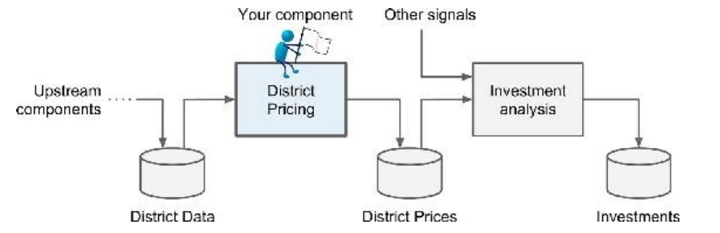
Framing the Problem
Understand the Business Objective and Context
What is the expected usage and benefit?
impacts the choice of algorithms, goodness measure, and effort in lifecycle management of the model
What is the baseline method and its performance?

Slide 8
Choice of Model
Choose between Different techniques
Supervised or unsupervised? Prediction or classification? Online Vs. Batch? Instance-based or Model-based?
Analyze the dataset
Each instance comes with the expected output, i.e., the district’s median housing price.
supervised
Goal is to predict a real valued price based on multiple variables line population, income etc.
regression
Output is based on input data at rest, not rapidly changing data rapidly.
Dataset small enough to fit in memory
batch
So, it’s a supervised multivariate batch regression problem
cv
cv

Slide 9
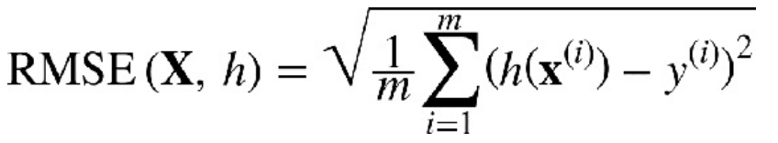
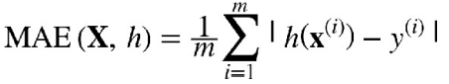
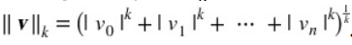
Choice of Performance Metrics
A typical Choice for Regression: Root Mean Square Error (RMSE)
h is the model, X is the training dataset, m is number of instances, x^{(i)} is i-th instance, y^{(i)} is the actual price for the i-th instance.
Mean Absolute Error (MAE)
MAE is preferred for a large number of outliers. aka L₁ norm or Manhattan distance/norm.
General Form

Slide 10
Stepping Back
Check the Assumptions
Verify that the downstream module actually uses real-valued prices rather than post processing them into say, categories, e.g “cheap,” “medium,” or “expensive”)
If not, the problem should have been framed as a classification task, not a regression task.
Such potential hazards need to be checked early in the design rather than finding out from deployed systems

Slide 11
Topic 2
 | Data Types

Slide 12
What is Data?
Collection of data objects and attributes
Attributes
An attribute is a property or characteristic of an object
Examples: eye color of a person, temperature, etc.
aka variable, field, characteristic, dimension, or feature
A collection of attributes describe an object
aka record, point, case, sample, entity, or instance
Attribute values are numbers or symbols assigned to an attribute for a particular object
Distinction between attributes and attribute values
Same attribute can be mapped to different attribute values
Example: height can be measured in feet or meters
Different attributes can be mapped to the same set of values
Example: Attribute values for ID and age are integers
But properties of attribute can be different than the properties of the values used to represent the attribute
Objects

Slide 13
Discrete and Continuous Attributes
Discrete Attribute
Has only a finite or countably infinite set of values
Examples: zip codes, counts, or the set of words in a collection of documents
Often represented as integer variables.
Note: binary attributes are a special case of discrete attributes
Continuous Attribute
Has real numbers as attribute values
Examples: temperature, height, or weight.
Practically, real values can only be measured and represented using a finite number of digits.
Continuous attributes are typically represented as floating-point variables.

Slide 14
Types and properties of Attributes
Types
Nominal
ID numbers, eye color, zip codes
Ordinal
rankings (e.g., taste of potato chips on a scale from 1-10), grades, height {tall, medium, short}
Interval
calendar dates, temperatures in Celsius or Fahrenheit.
Ratio
temperature in Kelvin, length, counts, elapsed time (e.g., time to run a race)
Properties
Distinctness: = ≠
Order: < >
Differences are + - meaningful :
Ratios are * / meaningful :

Slide 15
Categorization of Attributes

Slide 16
Transformation of Attributes

Slide 17
Important Characteristics of Data
Dimensionality (number of attributes)
High dimensional data brings a number of challenges
Sparsity
Only presence counts
Resolution
Patterns depend on the scale
Size
Type of analysis may depend on size of data

Slide 18
Types of data sets
1.Record
Data Matrix
Document Data
Transaction Data
2.Graph
World Wide Web
Molecular Structures
3.Ordered
Spatial Data
Temporal Data
Sequential Data
Genetic Sequence Data

Slide 19
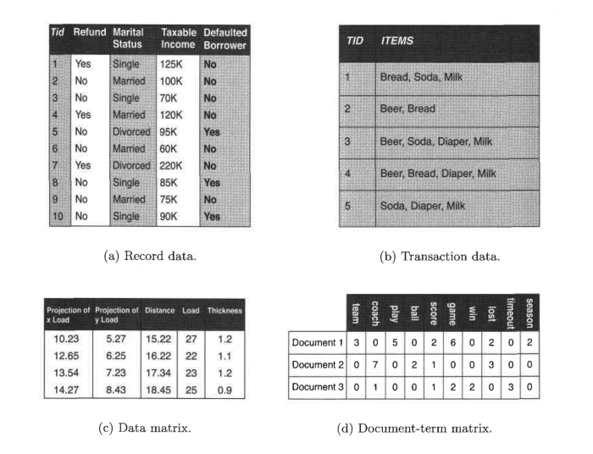
Types of data sets
Record
Data Matrix
Document Data
Transaction Data

Slide 20
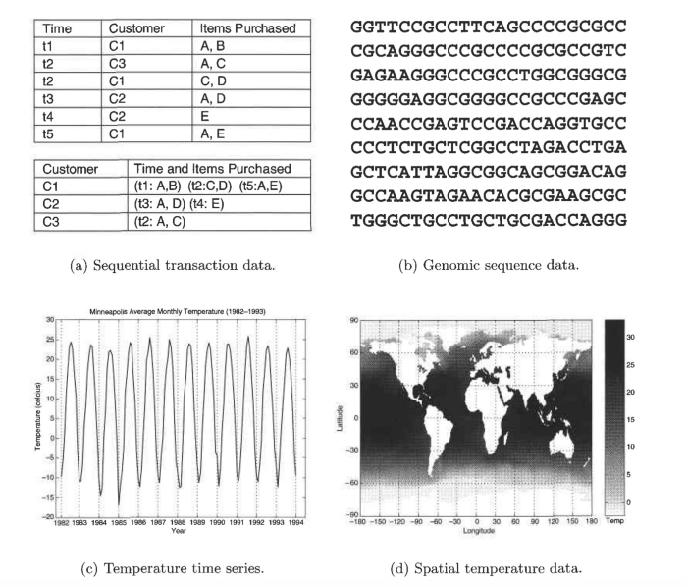
Types of data sets
Ordered
Spatial Data
Temporal Data
Sequential Data
Genetic Sequence Data

Slide 21
Graph Data
Benzene Molecule: C6H6

Slide 22
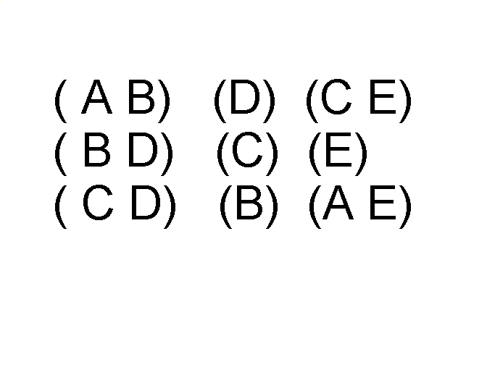
Ordered Data
Sequence of transactions
Items/Events
An element of the sequence

Slide 23
Ordered Data
Genomic sequence data

Slide 24
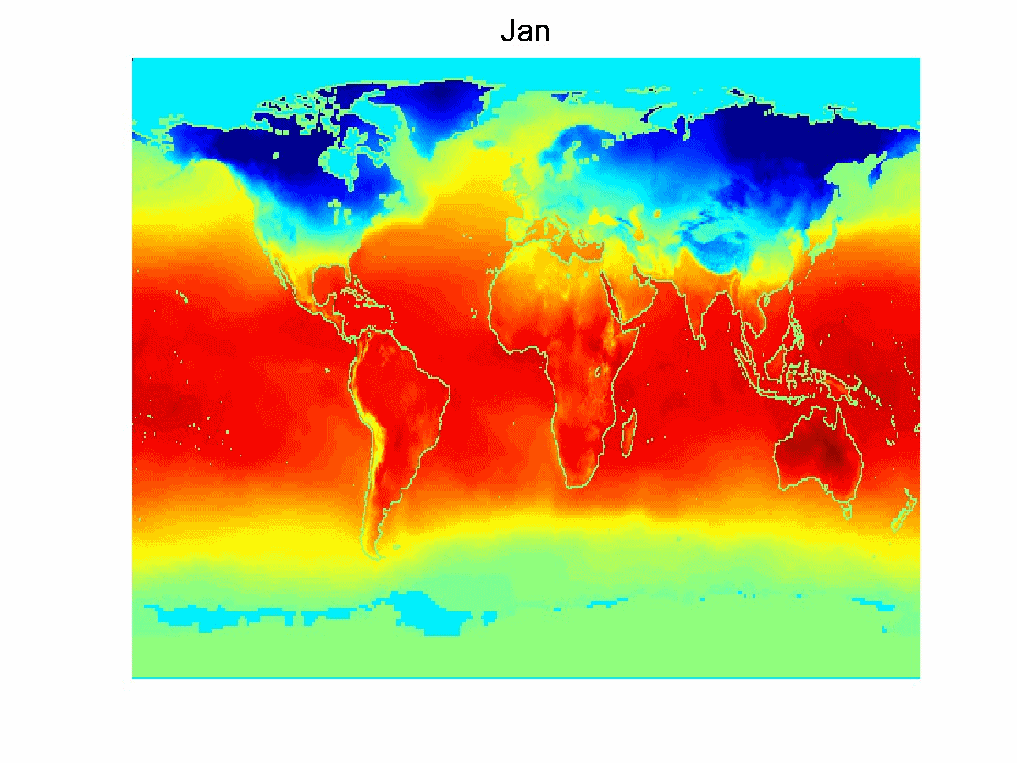
Ordered Data
SpatioTemporal Data
Average Monthly Temperature of land and ocean

Slide 25
Topic 3
 | Data Pre-processing

Slide 26
In this segment
Data Preprocessing
1.Data Quality
Noise, Outlier, Missing attribute, Duplicate record
2.Data Transformation
Aggregation
Sampling
Discretization and Binarization
Attribute Transformation
Dimensionality Reduction
Feature subset selection
Feature creation

Slide 27

Noise
For objects, noise is an extraneous object
For attributes, noise refers to modification of original values
Examples: distortion of a person’s voice when talking on a poor phone and “snow” on television screen
The figures below show two sine waves of the same magnitude and different frequencies, the waves combined, and the two sine waves with random noise
The magnitude and shape of the original signal is distorted

Slide 28

Outliers
Outliers are data objects with characteristics that are considerably different than most of the other data objects in the data set
Case 1: Outliers are noise that interferes with data analysis
Case 2: Outliers are the goal of our analysis
Credit card fraud
Intrusion detection

Slide 29
Missing Values
Reasons for missing values
Information is not collected (e.g., people decline to give their age and weight)
Attributes may not be applicable to all cases (e.g., annual income is not applicable to children)
Handling missing values
Eliminate data objects or variables
Estimate missing values
Example: time series of temperature
Example: census results
Ignore the missing value during analysis

Slide 30
Duplicate Data
Data set may include data objects that are duplicates, or almost duplicates of one another
Major issue when merging data from heterogeneous sources
Examples:
Same person with multiple email addresses
Data cleaning
Process of dealing with duplicate data issues

Slide 31
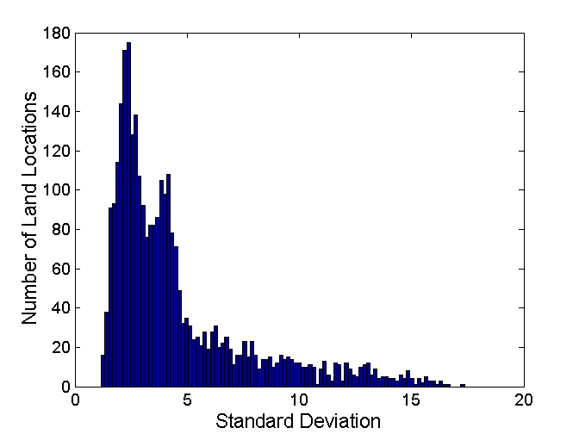
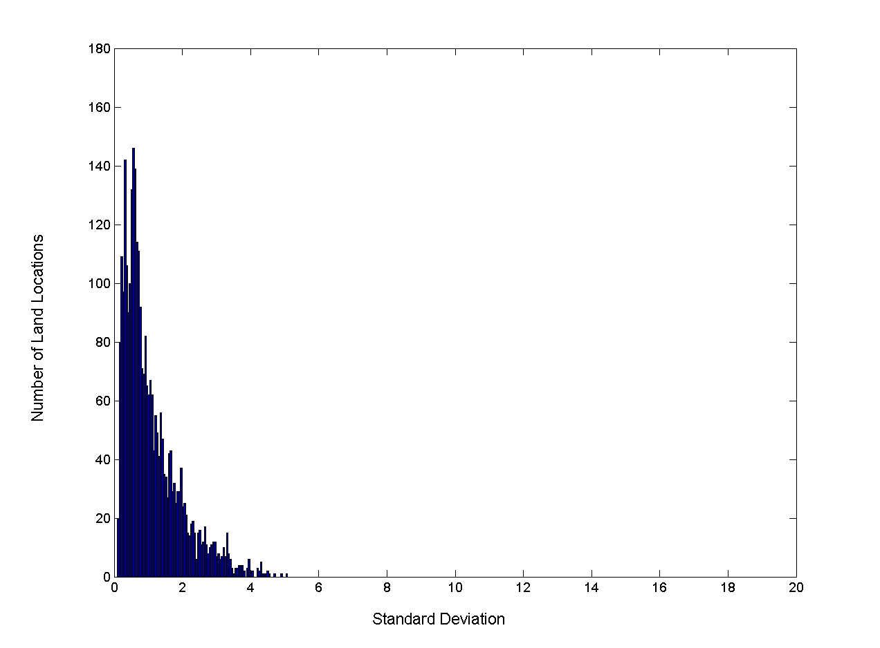
Aggregation
Combining two or more attributes (or objects) into a single attribute (or object)
Purpose
Data reduction
Change of scale
More “stable” data
Standard Deviation of Average Monthly Precipitation
Standard Deviation of Average Yearly Precipitation

Slide 32

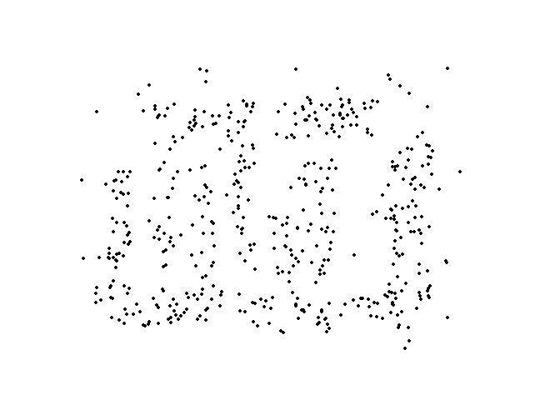
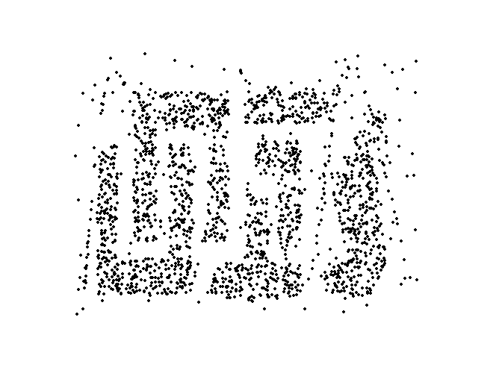
Sampling
Primary technique used for data reduction
It is often used for both the preliminary investigation of the data and the final data analysis.
Statisticians often sample because obtaining the entire set of data of interest is too expensive or time consuming.
Sampling is typically used in machine learning because processing the entire set of data of interest may be too expensive or time consuming.
Key Principle
Using a sample will work almost as well as using the entire data set, if the sample is representative
A sample is representative if it has approximately the same properties as the original dataset
8000 points 2000 Points 500 Points

Slide 33
Sampling …
The key principle for effective sampling is the following:
Using a sample will work almost as well as using the entire data set, if the sample is representative
A sample is representative if it has approximately the same properties (of interest) as the original set of data
Simple Random Sampling
There is an equal probability of selecting any particular item
Sampling without replacement
As each item is selected, it is removed from the population
Sampling with replacement
Objects are not removed from the population as they are selected for the sample.
In sampling with replacement, the same object can be picked up more than once
Stratified sampling
Split the data into several partitions; then draw random samples from each partition

Slide 34
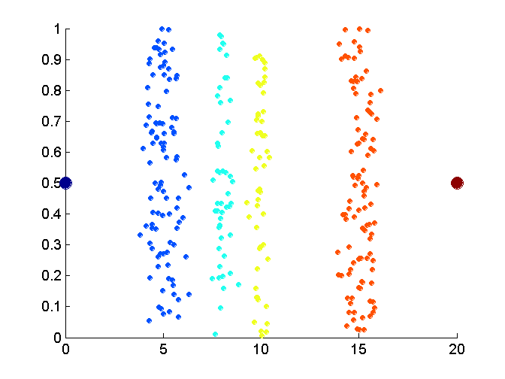
Discretization
Process of converting a continuous attribute into an ordinal attribute
A potentially infinite number of values are mapped into a small number of categories
Discretization is used in both unsupervised and supervised settings
Data consists of four groups of points and two outliers. Data is one-dimensional, but a random y component is added to reduce overlap.

Slide 35
Binarization
Maps a continuous or categorical attribute into one or more binary variables
Often convert a continuous attribute to a categorical attribute and then convert a categorical attribute to a set of binary attributes
Examples: eye color and height measured as {low, medium, high}

Slide 36
Attribute Transformation
Maps the entire set of values of a given attribute to a new set of replacement values
Each original value can be identified with one of the new values
Simple functions: x^{k}, log(x), e^{x}, |x|
Normalization
Refers to various techniques to adjust to differences among attributes in terms of frequency of occurrence, mean, variance, range
Take out unwanted, common signal, e.g., seasonality
In statistics, standardization refers to subtracting off the means and dividing by the standard deviation

Slide 37
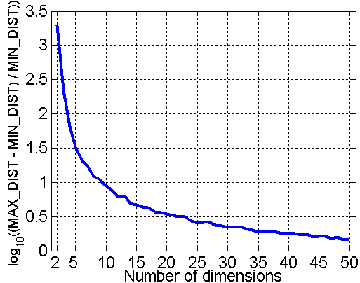
Curse of Dimensionality
When dimensionality increases, data becomes increasingly sparse in the space that it occupies
Definitions of density and distance between points, which are critical for clustering and outlier detection, become less meaningful
Randomly generate 500 points
Compute difference between max and min distance between any pair of points

Slide 38
Dimensionality Reduction
Purpose
Avoid curse of dimensionality
Reduce amount of time and memory required by ML algorithms
Allow data to be more easily visualized
May help to eliminate irrelevant features or reduce noise
Popular Techniques
Principal Components Analysis (PCA)
Singular Value Decomposition
Find a projection that captures the largest amount of variation in data
x₂
e
x₁

Slide 39
Feature Subset Selection
Another way to reduce dimensionality of data
Redundant features
Duplicate much or all of the information contained in one or more other attributes
Example: purchase price of a product and the amount of sales tax paid
Irrelevant features
Contain no information that is useful for the ML task at hand
Example: students' ID is often irrelevant to the task of predicting students' GPA
Many techniques developed, especially for classification

Slide 40
Feature Creation
Create new attributes that can capture the important information in a data set
More efficiently than the original attributes
Three general methodologies
Feature extraction
Example: extracting edges from images
Feature construction
Example: dividing mass by volume to get density
Mapping data to new space
Example: Fourier and wavelet analysis

Slide 41
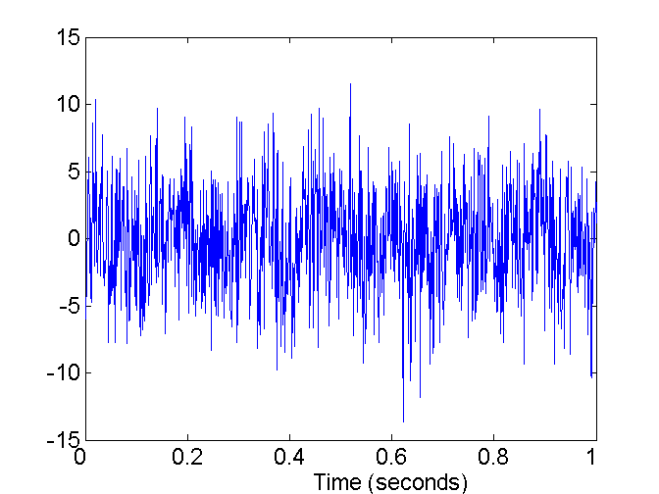
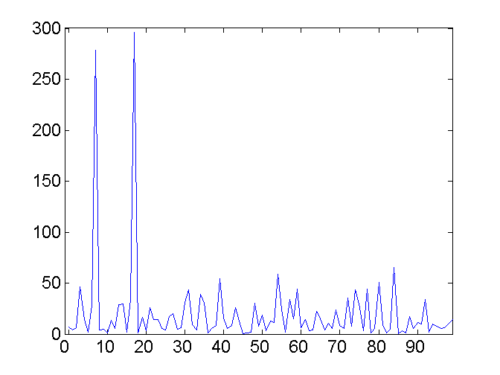
Mapping Data to a New Space
Fourier and wavelet transform - Two Sine Waves + Noise
Frequency

Slide 42
Topic - 4
 | Data Analysis

Slide 43
What is data exploration?
A preliminary exploration of the data to better understand its characteristics
Key motivations of data exploration include
Helping to select the right tool for preprocessing or analysis
Making use of humans’ abilities to recognize patterns
People can recognize patterns not captured by data analysis tools
Related to the area of Exploratory Data Analysis (EDA)
The focus was on visualization
Clustering and anomaly detection were viewed as exploratory techniques
In machine learning, clustering and anomaly detection are major areas of interest, and not thought of as just exploratory

Slide 44
Summary Statistics of Data
Numbers that summarize properties of the data
Summarized properties include frequency, location and spread
Examples: location – mean, spread - standard deviation
Most summary statistics can be calculated in a single pass through the data

Slide 45
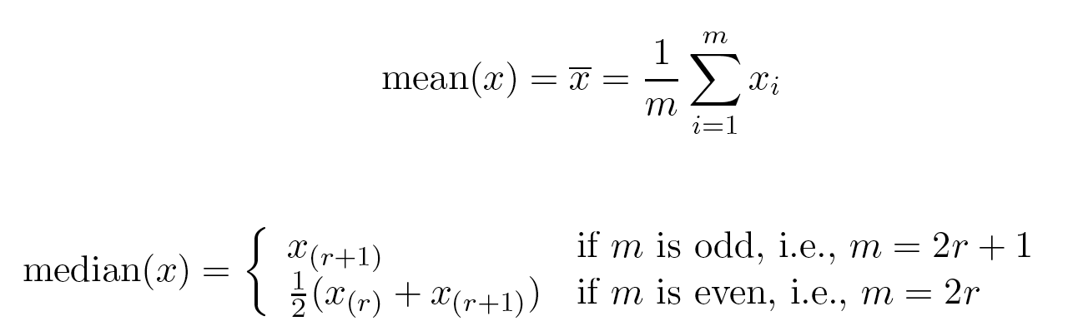
Measures of Location: Mean and Median
The mean is the most common measure of the location of a set of points.
However, the mean is very sensitive to outliers.
Thus, the median or a trimmed mean is also commonly used.
Assuming sorted {x_{i}}

Slide 46
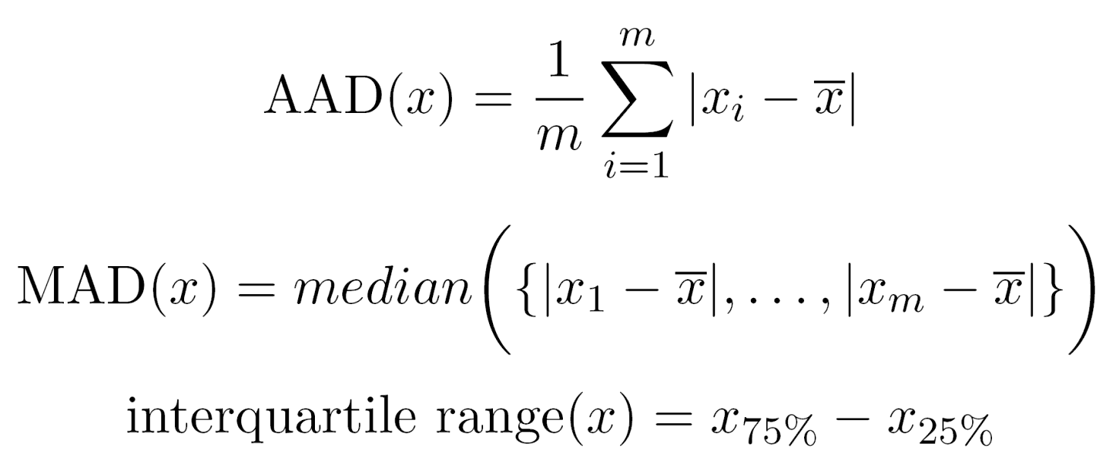
Measures of Spread: Range and Variance
Range is the difference between the max and min
The variance or standard deviation s_{x} is the most common measure of the spread of a set of points.
Because of outliers, other measures are often used. Average Absolute Distance is given by

Slide 47
Similarity and Dissimilarity Measures
Similarity measure
Numerical measure of how alike two data objects are.
Is higher when objects are more alike.
Often falls in the range [0,1]
Dissimilarity measure
Numerical measure of how different two data objects are
Lower when objects are more alike
Minimum dissimilarity is often 0
Upper limit varies
Proximity refers to a similarity or dissimilarity

Slide 48
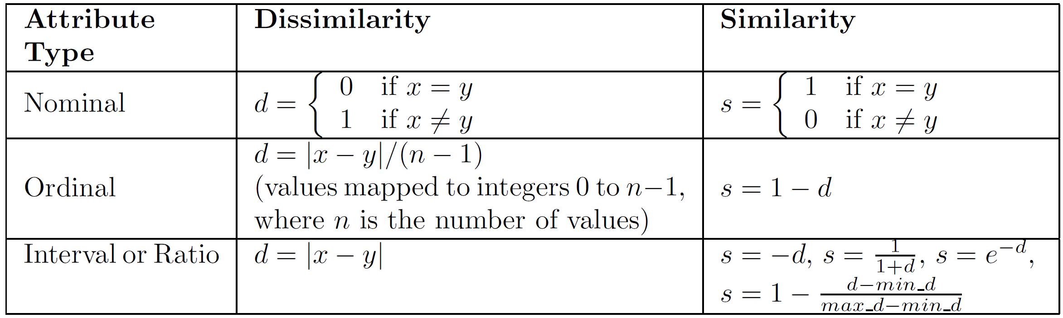
Similarity/Dissimilarity for Simple Attributes
The following table shows the similarity and dissimilarity between two objects, x and y, with respect to a single, simple attribute.

Slide 49
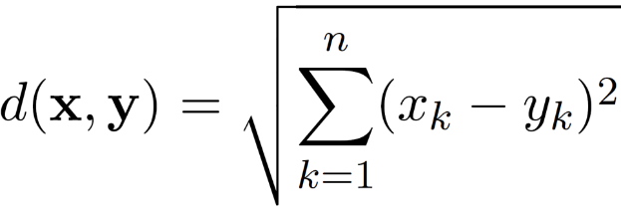
Euclidean Distance
Euclidean Distance
where n is the number of dimensions (attributes) and x_{k} and y_{k} are, respectively, the k^{th} attributes (components) or data objects x and y.
Standardization is necessary, if scales differ.

Slide 50
Euclidean Distance
Distance Matrix

Slide 51
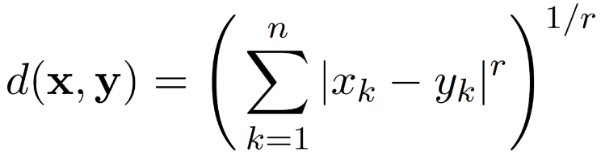
Minkowski Distance
Minkowski Distance is a generalization of Euclidean Distance
where r is a parameter, n is the number of dimensions (attributes) and x_{k} and y_{k} are, respectively, the k^{th} attributes (components) or data objects x and y.

Slide 52
Minkowski Distance: Examples
r = 1. City block (Manhattan, taxicab, L₁ norm) distance.
A common example of this for binary vectors is the Hamming distance, which is just the number of bits that are different between two binary vectors
r = 2. Euclidean distance
r → ∞. “supremum” (L_{max} norm, L∞ norm) distance.
This is the maximum difference between any component of the vectors
Do not confuse r with n, i.e., all these distances are defined for all numbers of dimensions.

Slide 53
Minkowski Distance
Distance Matrix

Slide 54
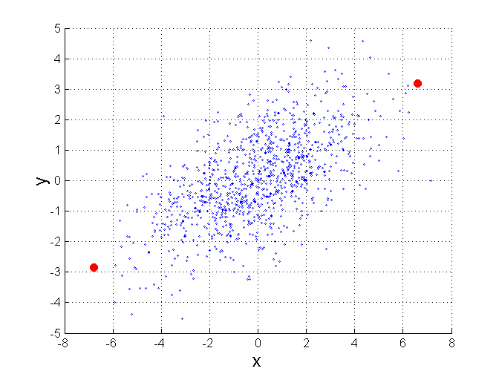
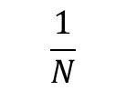
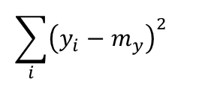
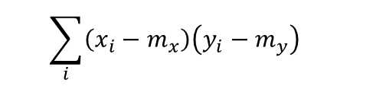
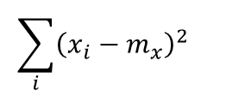
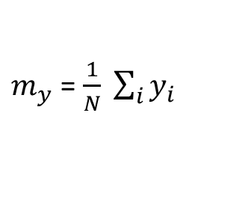
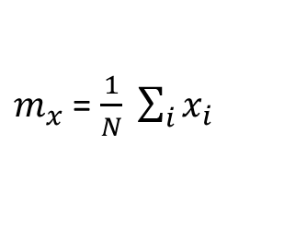
Mahalanobis Distance
$mahalanobis\left(x,y\right)={ ((x−y)}^{T}Ʃ^{−1}(x−y))$^{-0.5}
Σ is the covariance matrix
$$\sum_{i}{{\left(x_{i}−m_{x}\right)}^{2} }$$
$$\sum_{i}{{\left(x_{i}−m_{x}\right)\left(y_{i}−m_{y}\right)}^{ } }$$
$$\frac{1}{N}$$
$$\sum_{i}{{\left(x_{i}−m_{x}\right)\left(y_{i}−m_{y}\right)}^{ } }$$
$$\sum_{i}{{\left(y_{i}−m_{y}\right)}^{2} }$$
$m_{x}$ = $\frac{1}{N} \sum_{i}{x_{i}}$
$m_{y}$ = $\frac{1}{N} \sum_{i}{y_{i}}$
For red points, the Euclidean distance is 14.7, Mahalanobis distance is 6.

Slide 55
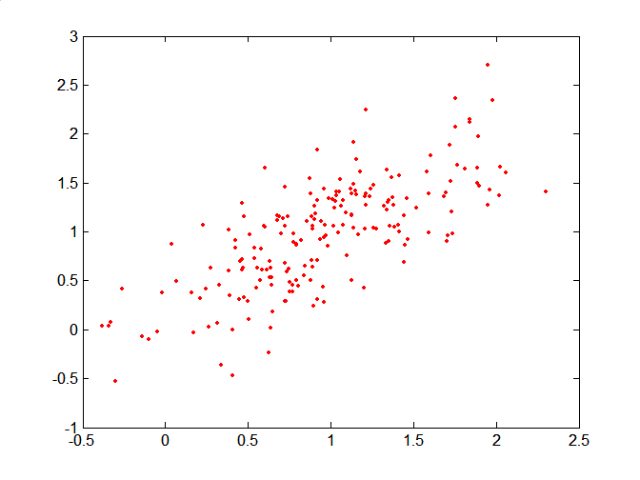
Mahalanobis Distance
Covariance Matrix:
C
A: (0.5, 0.5)
B: (0, 1)
C: (1.5, 1.5)
Mahal(A,B) = 5
Mahal(A,C) = 4
B
A

Slide 56
Similarity Between Binary Vectors
Common situation is that objects, x and y, have only binary attributes
Compute similarities using the following quantities
f₀₁ = the number of attributes where x was 0 and y was 1
f₁₀ = the number of attributes where x was 1 and y was 0
f₀₀ = the number of attributes where x was 0 and y was 0
f₁₁ = the number of attributes where x was 1 and y was 1
Simple Matching and Jaccard Coefficients
SMC = number of matches / number of attributes
= (f₁₁ + f₀₀) / (f₀₁ + f₁₀ + f₁₁ + f₀₀)
J = number of 11 matches / number of non-zero attributes
= (f₁₁) / (f₀₁ + f₁₀ + f₁₁)

Slide 57
SMC versus Jaccard: Example
x = 1 0 0 0 0 0 0 0 0 0
y = 0 0 0 0 0 0 1 0 0 1
f₀₁ = 2 (the number of attributes where x was 0 and y was 1)
f₁₀ = 1 (the number of attributes where x was 1 and y was 0)
f₀₀ = 7 (the number of attributes where x was 0 and y was 0)
f₁₁ = 0 (the number of attributes where x was 1 and y was 1)
SMC = (f₁₁ + f₀₀) / (f₀₁ + f₁₀ + f₁₁ + f₀₀)
= (0+7) / (2+1+0+7) = 0.7
J = (f₁₁) / (f₀₁ + f₁₀ + f₁₁) = 0 / (2 + 1 + 0) = 0

Slide 58
Cosine Similarity
If d₁ and d₂ are two document vectors, then
Cos( d₁, d₂ ) = <d₁,d₂> / ||d₁|| ||d₂|| ,
where <d₁,d₂> indicates inner product or vector dot product of vectors, d₁ and d_{2,} and || d || is the length of vector d.
Example:
d₁ = 3 2 0 5 0 0 0 2 0 0
d₂ = 1 0 0 0 0 0 0 1 0 2
<d₁, d2> = 3*1 + 2*0 + 0*0 + 5*0 + 0*0 + 0*0 + 0*0 + 2*1 + 0*0 + 0*2 = 5
| d₁ || = (3*3+2*2+0*0+5*5+0*0+0*0+0*0+2*2+0*0+0*0)^{0.5} = (42) ^{0.5} = 6.481
|| d₂ || = (1*1+0*0+0*0+0*0+0*0+0*0+0*0+1*1+0*0+2*2) ^{0.5} = (6) ^{0.5} = 2.449
Cos(d₁, d₂ ) = 0.3150

Slide 59
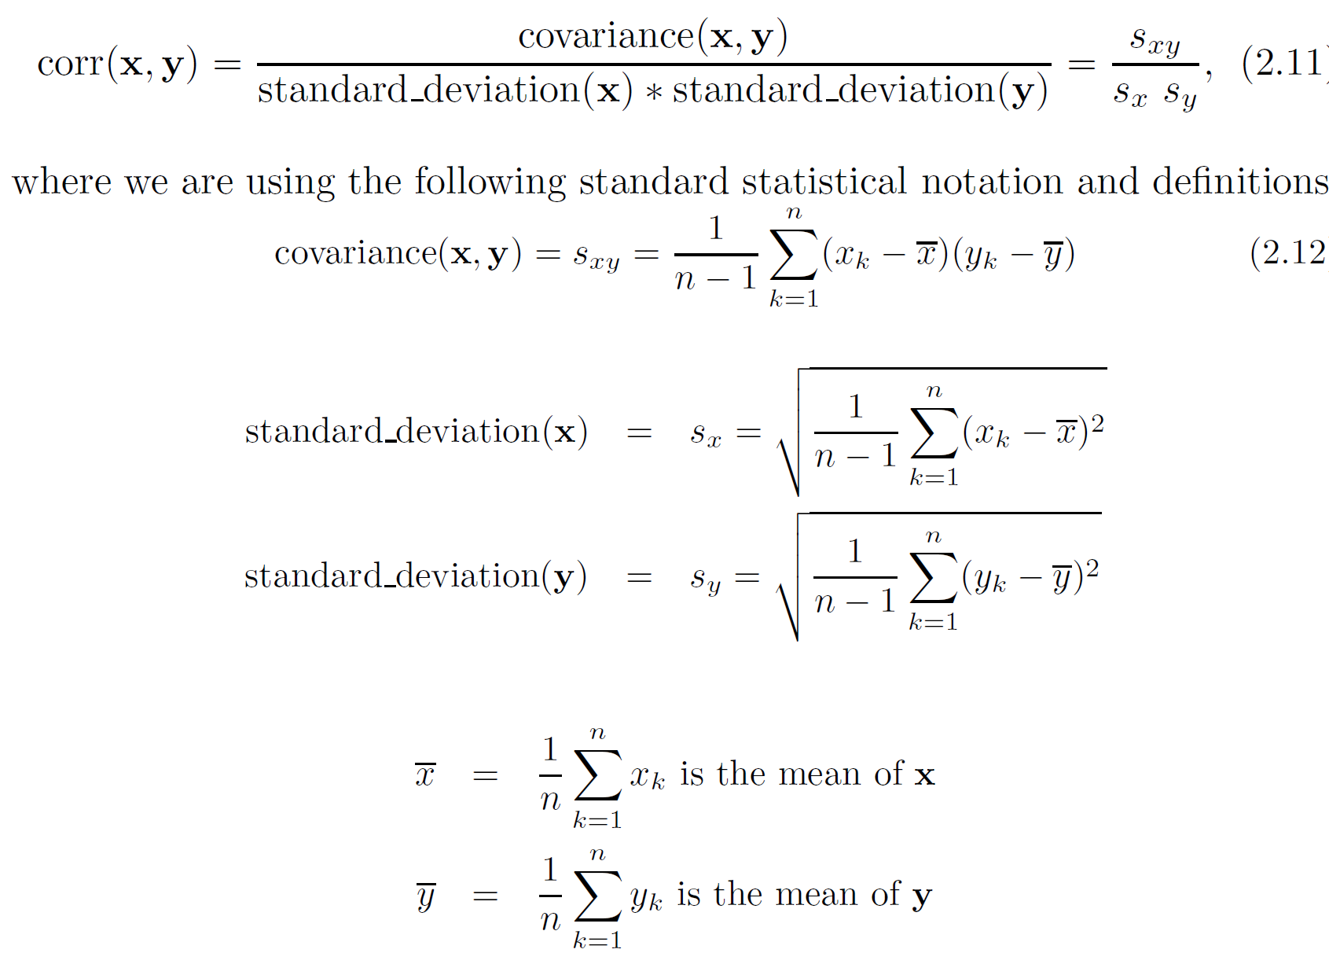
Correlation measures the linear relationship between objects

Slide 60
Correlation vs Cosine vs Euclidean Distance
Compare the three proximity measures according to their behavior under variable transformation
scaling: multiplication by a value
translation: adding a constant
Consider the example
x = (1, 2, 4, 3, 0, 0, 0), y = (1, 2, 3, 4, 0, 0, 0)
y_{s} = y * 2 (scaled version of y), y_{t} = y + 5 (translated version)
Property | Cosine | Correlation | Euclidean Distance
Invariant to scaling (multiplication) | Yes | Yes | No
Invariant to translation (addition) | No | Yes | No
Measure | (x , y) | (x , y_{s}) | (x , y_{t})
Cosine | 0.9667 | 0.9667 | 0.7940
Correlation | 0.9429 | 0.9429 | 0.9429
Euclidean Distance | 1.4142 | 5.8310 | 14.2127

Slide 61
Correlation vs cosine vs Euclidean distance
Choice of the right proximity measure depends on the domain
What is the correct choice of proximity measure for the following situations?
Comparing documents using the frequencies of words
Documents are considered similar if the word frequencies are similar
Comparing the temperature in Celsius of two locations
Two locations are considered similar if the temperatures are similar in magnitude
Comparing two time series of temperature measured in Celsius
Two time series are considered similar if their “shape” is similar, i.e., they vary in the same way over time, achieving minimums and maximums at similar times, etc.

Slide 62
Comparison of Proximity Measures
Domain of application
Similarity measures tend to be specific to the type of attribute and data
Record data, images, graphs, sequences, 3D-protein structure, etc. tend to have different measures
However, one can talk about various properties that you would like a proximity measure to have
Symmetry is a common one
Tolerance to noise and outliers is another
Ability to find more types of patterns?
Many others possible
The measure must be applicable to the data and produce results that agree with domain knowledge

Slide 63
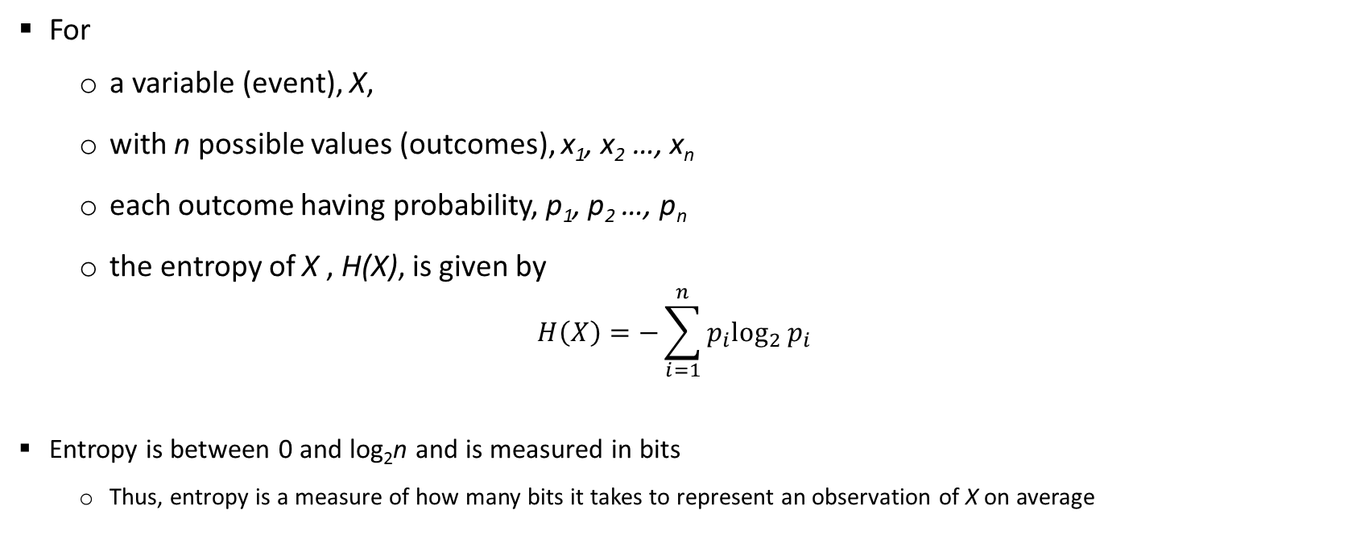
Entropy
For
a variable (event), X,
with n possible values (outcomes), x₁, x₂ …, x_{n}
each outcome having probability, p₁, p₂ …, p_{n}
the entropy of X , H(X), is given by
$$H\left(X\right)=−\sum_{i=1}^{n}{{p_{i}log}_{2}{p_{i}}}$$
Entropy is between 0 and log₂n and is measured in bits
Thus, entropy is a measure of how many bits it takes to represent an observation of X on average

Slide 64
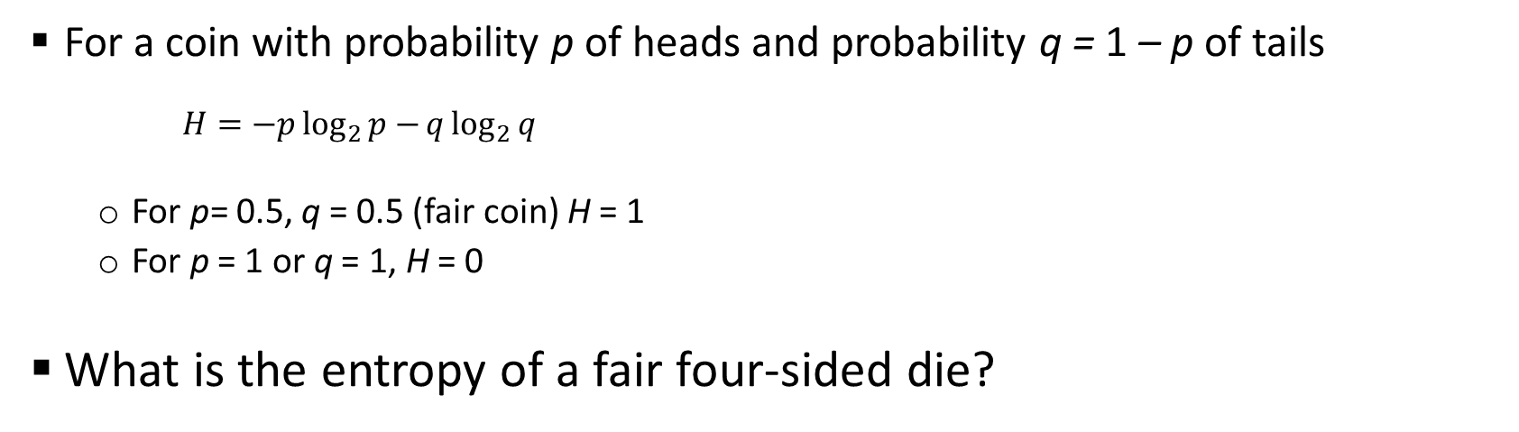
Entropy Examples
For a coin with probability p of heads and probability q = 1 – p of tails
$$H=−p\log_{2}{p−}q\log_{2}{q}$$
For p= 0.5, q = 0.5 (fair coin) H = 1
For p = 1 or q = 1, H = 0
What is the entropy of a fair four-sided die?

Slide 65
Entropy for Sample Data: Example
Hair Color | Count | p | -plog₂p
Black | 75 | 0.75 | 0.3113
Brown | 15 | 0.15 | 0.4105
Blond | 5 | 0.05 | 0.2161
Red | 0 | 0.00 | 0
Other | 5 | 0.05 | 0.2161
Total | 100 | 1.0 | 1.1540
Maximum entropy is log₂5 = 2.3219

Slide 66
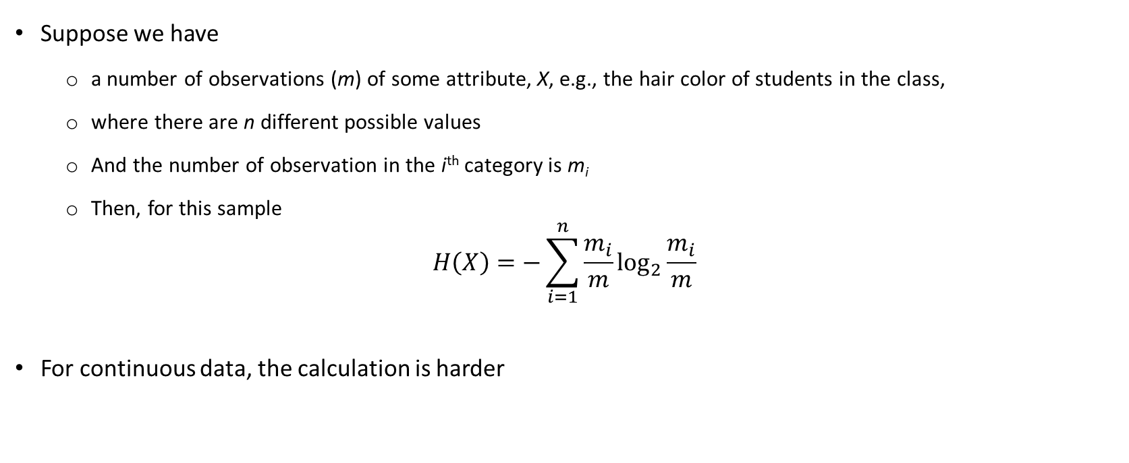
Entropy for Sample Data
Suppose we have
a number of observations (m) of some attribute, X, e.g., the hair color of students in the class,
where there are n different possible values
And the number of observation in the i^{th} category is m_{i}
Then, for this sample
$$H\left(X\right)=−\sum_{i=1}^{n}{{\frac{m_{i}}{m}log}_{2}{\frac{m_{i}}{m}}}$$
For continuous data, the calculation is harder

Slide 67
Topic 5
 | Data Visualization

Slide 68
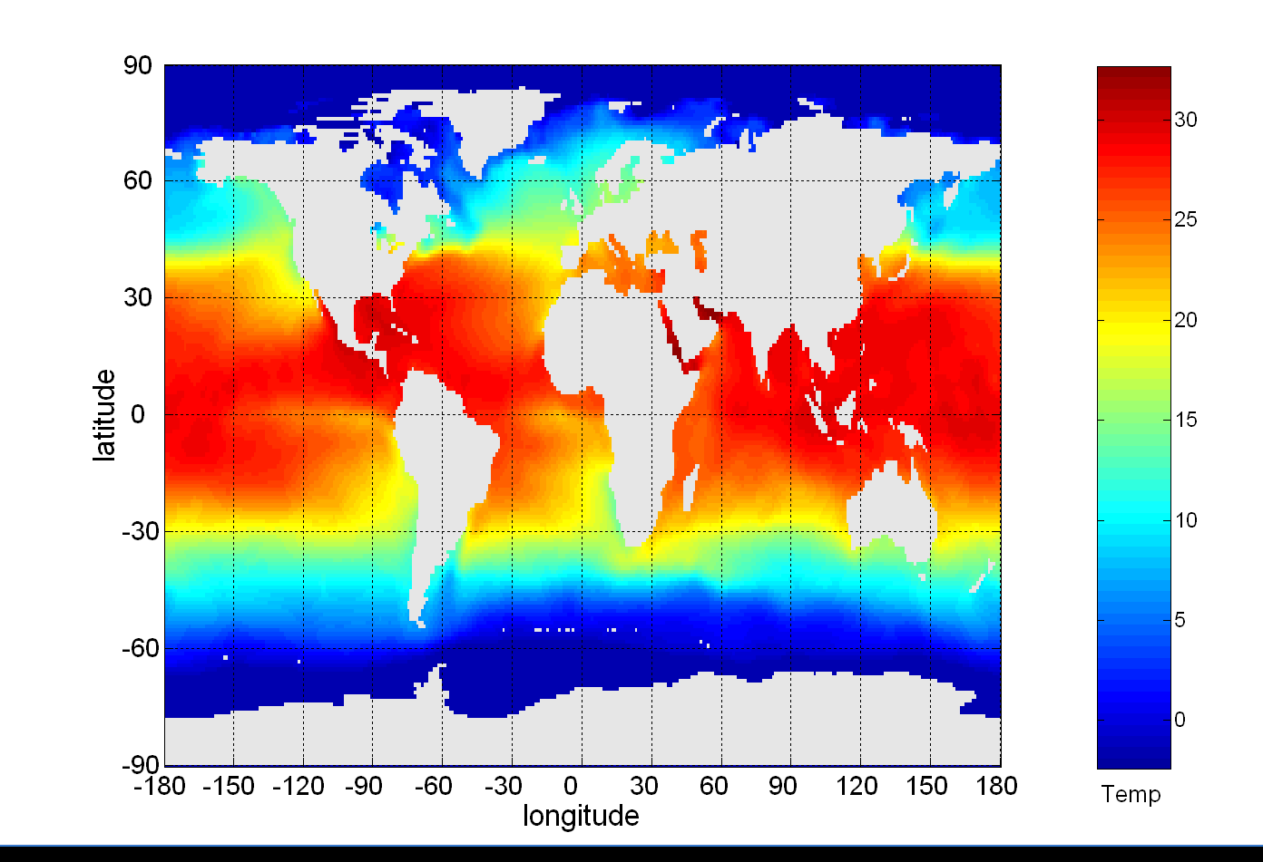
Visualization
Conversion of data into a visual or tabular format
Visualization of data is one of the most powerful and appealing techniques for data exploration.
Humans have a well developed ability to analyze large amounts of information that is presented visually
Can detect general patterns and trends
Can detect outliers and unusual patterns
Data objects, their attributes, and the relationships among data objects are translated into graphical elements such as points, lines, shapes, and colors.
Example:
Objects are often represented as points
Their attribute values can be represented as the position of the points or the characteristics of the points, e.g., color, size, and shape
Sea Surface Temperature (SST) for July 1982

Slide 69
Representation
Mapping information to a visual format
Data objects, their attributes, and the relationships among data objects are translated into graphical elements such as points, lines, shapes, and colors.
Example:
Objects are often represented as points
Their attribute values can be represented as the position of the points or the characteristics of the points, e.g., color, size, and shape
If position is used, then the relationships of points, i.e., whether they form groups or a point is an outlier, is easily perceived.

Slide 70
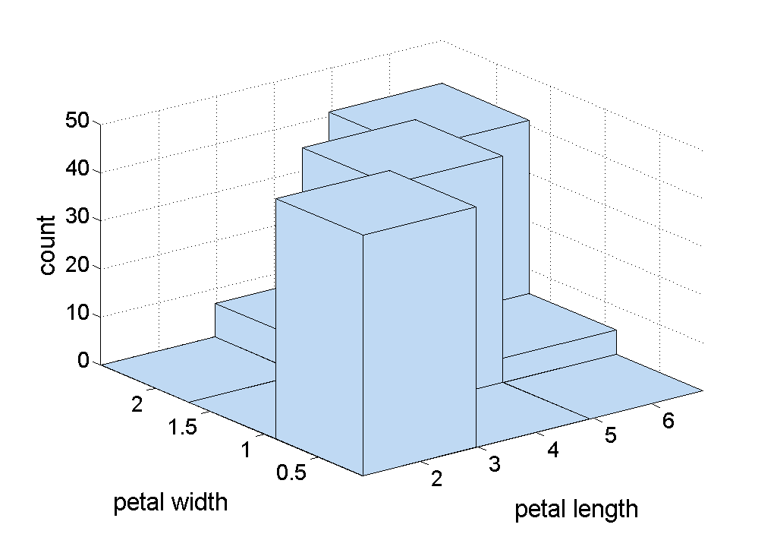
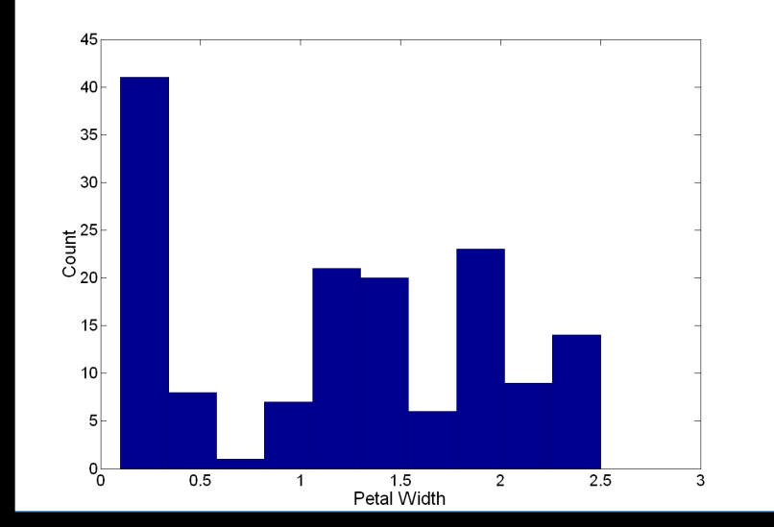
Visualization Techniques: Histograms
Histogram
Usually shows the distribution of values of a single variable
Divide the values into bins and show a bar plot of the number of objects in each bin.
The height of each bar indicates the number of objects
Shape of histogram depends on the number of bins
Example: Petal Width (10 and 20 bins, respectively)

Slide 71
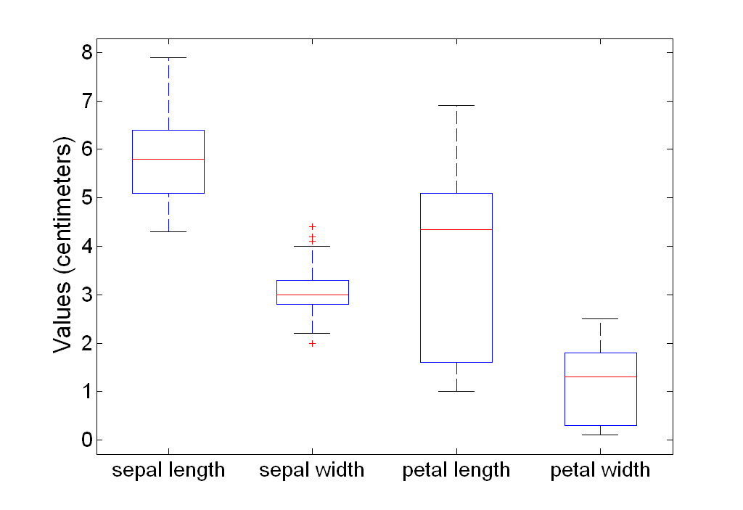
Visualization Techniques: Box Plots
Display distribution of data
outlier
90th percentile
75th percentile
50th percentile
25th percentile
10th percentile

Slide 72
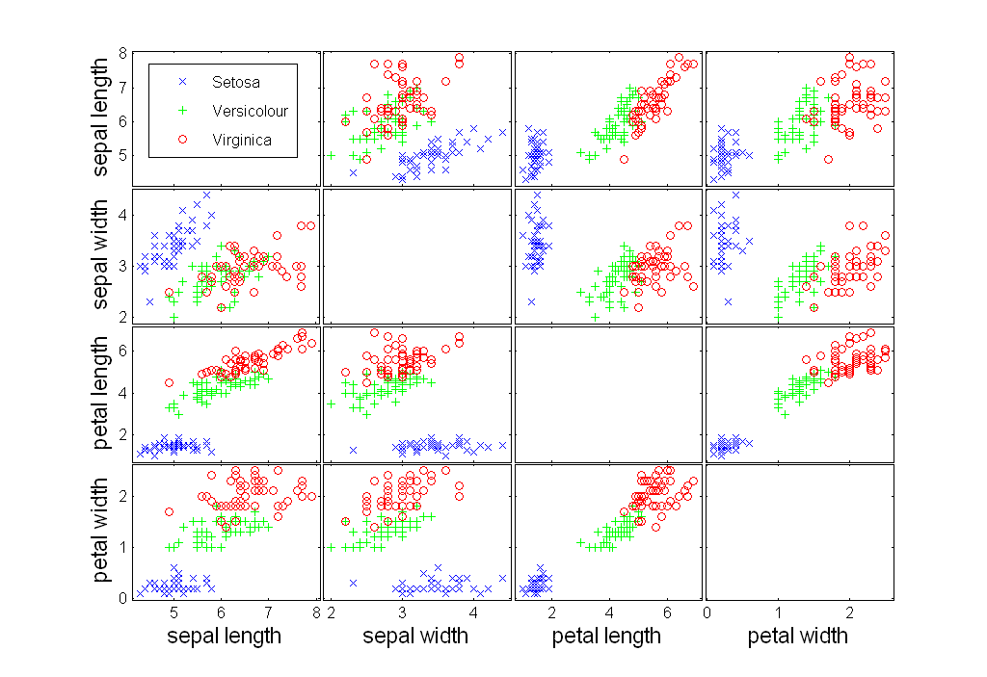
Visualization Techniques: Scatter Plots
Attributes values determine the position
Useful to have arrays of scatter plots can compactly summarize the relationships of several pairs of attributes

Slide 73
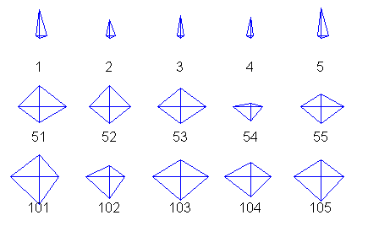
Star Plots for Iris Data
Setosa
Versicolour
Virginica

Slide 74
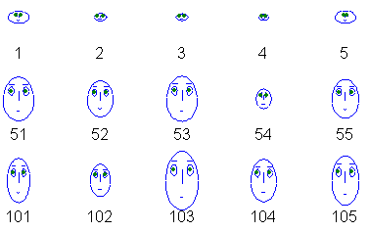
Chernoff Faces for Iris Data
Setosa
Versicolour
Virginica

Slide 75
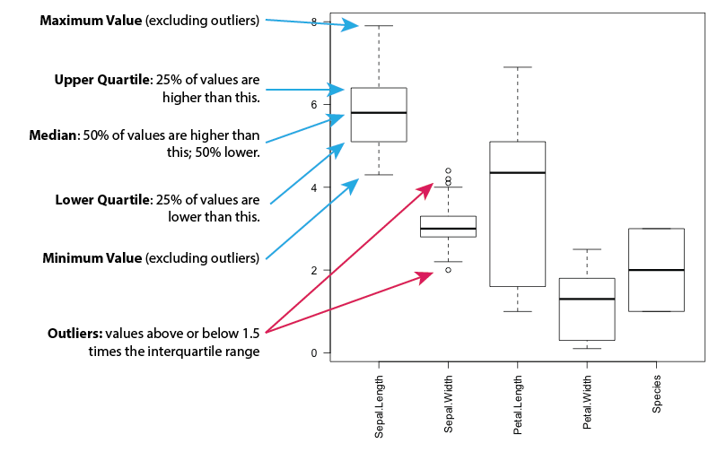
Visualization Techniques: Box Plots
Display distribution of data

Slide 76
Topic 5
 | Software Tools for ML

Slide 77
Prerequisites
Jupyter Notebook
Open-source web application to create and share live code, equations, visualizations and narrative text.
Used for data cleaning and transformation, numerical simulation, statistical modeling, data visualization, machine learning, and much more.
Easy to tinker with code and execute it in steps
Run in local browser: https://jupyter.org/try
Local installation: https://jupyter.org/install.html
Repository of Jupyter Notebooks: https://github.com/ageron/handson-ml
Colab
Google’s flavor of Jupyter notebooks tailored for machine learning and data analysis
Runs entirely in the cloud.
free access to hardware accelerators like GPUs and TPUs (with some restrictions).
http://colab.research.google.com
Popular Datasets
UC Irvine Machine Learning Repository: http://archive.ics.uci.edu/ml/
Kaggle datasets: https://www.kaggle.com/datasets
Amazon’s AWS datasets: http://aws.amazon.com/fr/datasets/

Slide 78
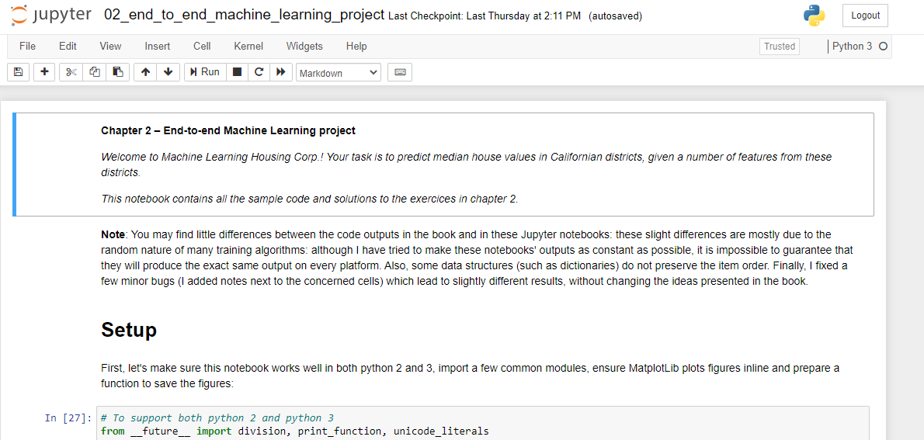
Local Installation
Preferred Mode
Install a virtual environment via Anaconda
Free Anaconda Python distribution: https://www.anaconda.com/products/individual
Download Python 3.* version

Slide 79
Prerequisites
Python and several scientific libraries
Python
high-level, dynamically typed multiparadigm programming language.
almost like pseudocode, very readable
Platform: Linux/Windows/MacOS
Documentation: https://www.python.org/doc/
Interactive Python tutorial: http://learnpython.org/
Stand alone installation: (preferably 3.7 or higher) https://www.python.org/downloads/
scikit-learn
Open source library that supports supervised and unsupervised learning.
Various model fitting, data preprocessing, model selection and evaluation tools, and other utilities.
Platform: Linux/Windows/MacOS
User guide: https://scikit-learn.org/stable/user_guide.html
Stand alone installation: https://scikit-learn.org/stable/install.html

Slide 80
Prerequisites
Important libraries
Numpy
Scientific computing library with Python
Provides high-performance multidimensional array (e.g., vector, matrix) and basic tools to compute with and manipulate these arrays, linear algebra, random number generators
https://numpy.org/doc/stable/reference/
https://numpy.org/install/
SciPy
Builds on numpy, provides functions that operate on numpy arrays
Useful for different types of scientific and engineering applications, integration, image processing, …
https://docs.scipy.org/doc/scipy/reference/tutorial/index.html
Standalone installation: https://scipy.org/install.html
Matplotlib
Plotting library
https://matplotlib.org/
https://matplotlib.org/tutorials/index.html
https://matplotlib.org/users/installing.html

Slide 81
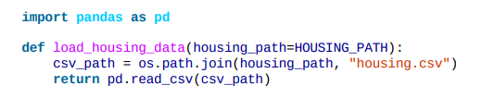
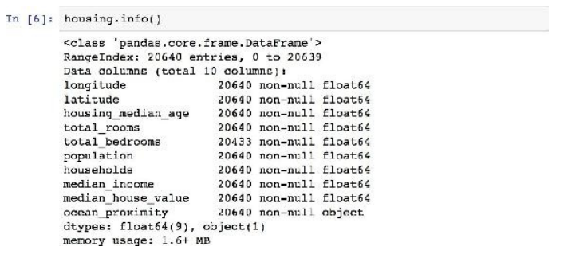
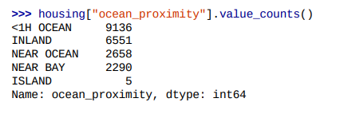
Important ML Steps and Functions
https://github.com/ageron/handson-ml/blob/master/02_end_to_end_machine_learning_project.ipynb
20,640 data instances in the dataset – fairly small
207 districts are missing total_bedrooms attribute
except ocean_proximity, rest of the attributes numerical
type of ocean_proximity is object, so it must be a text attribute - a repeated categorical attribute!

Slide 82
Important ML Steps and Functions
20,640 data instances in the dataset – fairly small
207 districts are missing total_bedrooms attribute
except ocean_proximity, rest of the attributes numerical
type of ocean_proximity is object, so it must be a text attribute - a repeated categorical attribute!

Slide 83
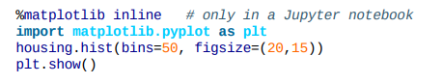
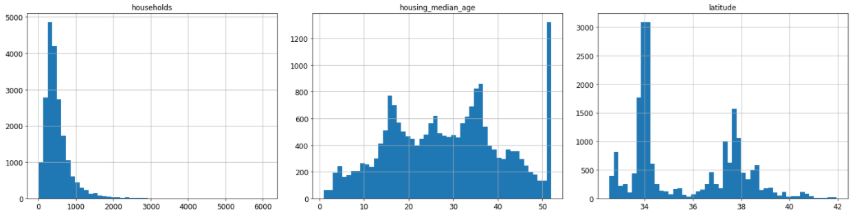
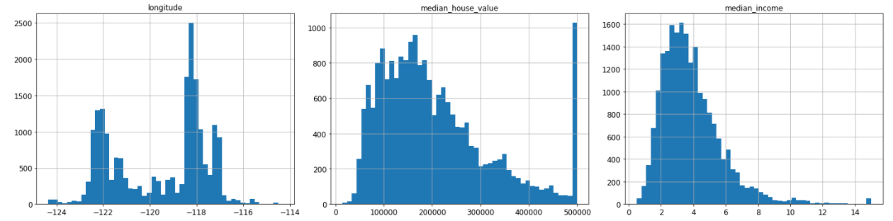
Attribute Visualization
age
latitude
# of households
longitude
price
income

Slide 84
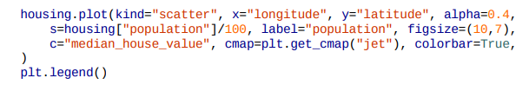
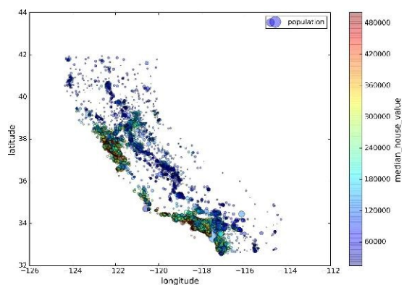
Visualizing Training Data for Insights

Slide 85


Correlations in Training Data
House prices are strongly correlated with income
small negative correlation between the latitude and the median house value
i.e., prices have a slight tendency to go down when you go north)
price cap clearly visible as a horizontal line at $500K.
Additional horizontal lines around $450k, $350K, perhaps one around $280K, ...

Slide 86


Experimenting with Attribute Combinations
Total number of rooms in a district not very useful
What may be important is the number of rooms per household.
Similarly, the total number of bedrooms compared to the number of rooms may be more meaningful
rooms_per_household is more correlated with price than total number of bedrooms or rooms.

Slide 87


Data Cleaning
Some of the instances don’t have total_bedroom values
Imputer utility in scikit-learn
Since median applies only to numerical data, create an copy of the data without ocean-proximity
The imputer stores the median of each attribute the result in its statistics_ instance variable.
Use this “trained” imputer to replace any missing values by the learned medians

Slide 88



Handling Textual and Categorical Data
Convert the text attributes to numbers
Scikit-learn provides a transformer
ML algorithms assume closer values are more similar. But ‘<1H OCEAN’ and ‘NEAR OCEAN’ are far away in values!
Solution! Use 1-hot encoding

Slide 89



Test Set Creation
Ensures reproducibility of results
Test set size is 20% of training set
Uses uniform sampling of data.
Not appropriate for heavy tailed distribution
income very important to predict house prices.
Important that test set is representative of the various categories of incomes in the dataset.
Most income values are around $20–$50K, but some >> $60K.
Histogram of income categories

Slide 90
Thank You!

